Slide 1



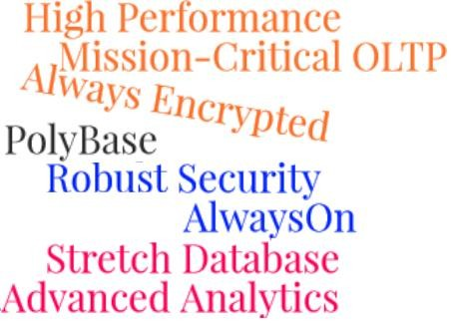
Session 16
SQL Server 2016
Introduction to SQL Server 2016

Slide 2
Objectives
SQL Server
2016
Describe an overview of SQL Server 2016
Outline the new features of SQL Server 2016
List and describe the different editions of SQL Server 2016

Slide 3
Introduction
SQL Server 2016
SQL Server 2016
Latest version of Microsoft’s database server
Brought major change in arenas such as speedy transactions, enhanced security, and hybrid cloud
AlwaysOn ensures database 100% database up-time
Enhanced Business Intelligence tools enable business for better data analytics
Supports data backup on cloud

Slide 4
What is New in SQL Server 2016 1-2
SQL Server
2016
Enhanced In-Memory
Always Encrypted
Advanced Analytics
Rich Visualizations
PolyBase Technology
Stretch Database
AlwaysOn
Consistent Experience

Slide 5
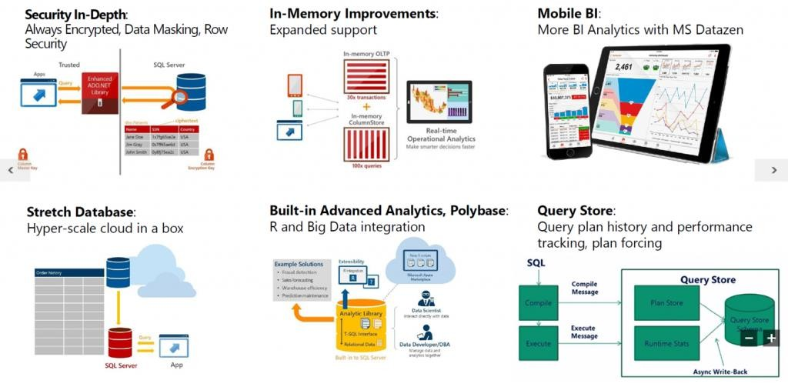
What is New in SQL Server 2016 2-2
SQL Server
2016
Pictorial representation of key features of SQL Server 2016 :

Slide 6
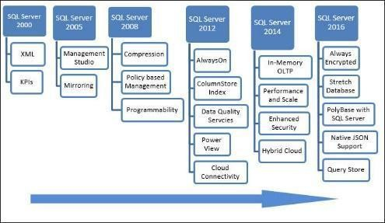
Evolution of SQL Server 2016
SQL Server
2016
Following figure shows the long journey of the flagship database product of Microsoft from year 2000 to the present:

Slide 7
Mission-Critical Performance 1-5
SQL Server
2016
Mission-critical performance is measured basically in terms of four parameters:
Performance Availability Scalability Security

Slide 8
Mission-Critical Performance 2-5
SQL Server
2016
Performance can be achieved through :
Operational Analytics
In-Memory OLTP improvements Query Data Store
Native JSON Temporal Tables

Slide 9
Mission-Critical Performance 3-5
SQL Server
2016
Higher Availability can be achieved through enhanced AlwaysOn feature by:
Up to three synchronous reproductions for auto fail-over across domain names
Round-robin method of load balancing of replicas
SQL Server Integration Services (SSIS) and Distributed Transaction Coordinator (DTC) support
Depending on the database health and support for automated failover
Notes:
Always on: tính năng sẳn sang khôi phục dữ liệu sau disaster

Slide 10
Mission-Critical Performance 4-5
SQL Server
2016
Improved Scability can be achieved through:
Enhanced Database Caching

Slide 11
Mission-Critical Performance 5-5
SQL Server
2016
Other than Always Encrypted security feature, the other security upgrades are:
Row Level Security
Information
Masking

Slide 12
Deeper Insights across Data 1-4
SQL Server
2016
SQL Server 2016 allows more flexibility in terms of data portability.
Access
Any Data
PolyBase
Power Query for Analytics and Reporting
Improved SQL Server
Integration Services
Notes:
Polybase: khả năng truy vấn dữ liệu phân tán

Slide 13
Deeper Insights across Data 2-4
SQL Server
2016
Scale and Manage
Features of new data management tools:
Enterprise-grade Analysis Services
SQL Server Data Tools (SSDT)
Enhanced Master Data Services (MDS)

Slide 14
Deeper Insights across Data 3-4
SQL Server
2016
Powerful Insights on any Device
SQL Server 2016 provides native apps for Power BI for Android, Windows, and iOS. Features are:
Mobile Business Intelligence (BI)
Query for reporting and Analytics
Notes:
Powerful Insights on any Device; thông tin chi tiết mạnh mẽ trên thiết bị bất kỳ

Slide 15
Deeper Insights across Data 4-4
SQL Server
2016
Built-in Advanced Analytics at Massive Scale
R algorithms can be directly executed on SQL Server through advanced analytics
R is a widely popular open-source programming language
R Enables
Advanced
analytics
Data
exploration
Machine
learning
R Services integrates a unique R distribution into the SQL
Server platform
R Services enables to create easily deployable, intelligent, and predictive applications

Slide 16

Hyper Scale Cloud
SQL Server
2016
Architecture of SQL Server 2016 enables the user to work smoothly with the cloud in a hybrid environment, in which data and services reside in different locations. This is achieved through:
Breakthrough Hybrid Situations
Uniformity
Ease

Slide 17
Various Editions of SQL Server 2016
SQL Server
2016
SQL Server Edition | Description
Enterprise | Delivers comprehensive high-end datacenter capabilities with super fast performance, unlimited virtualization, and end-to-end business intelligence.
Standard | Delivers basic data management and business intelligence database for medium to small-scale organizations to run their applications and supports tools for on- premise and cloud.
Web | Provides scalability, affordability, and manageability capabilities and delivers a low total-cost-of-ownership option for companies that are into Web hosting.
Developer | Delivers all the functionality of Enterprise edition to developers but is not intended to be used as a production server. Ideal for development and testing environments.
Express | Delivers an entry-level, free database and is ideal for learning and building desktop and small server data-driven applications. Also suitable for independent software vendors, developers, and hobbyists building client applications.

Slide 18
Summary
SQL Server
2016
SQL Server 2016
Great features: User can create better scalable, high performance, and more secure applications.
Hybrid cloud can be used whenever required.
New features: Stretch Database, Always Encrypted, Native JSON support, and PolyBase.
Enhanced features: In-Memory OLTP
Four main editions:
Enterprise, Standard, Express, and Developer
The Express Edition: Free and offers basic features.
Does not support: Advanced new features introduced in SQL Server 2016.
The Enterprise Edition: Premium edition, supports all the basic and advanced features.

